Slide 1


Subsea Field Development Proposal
Course: Flow Assurance
Professor: Phaneendra Kondapi, PhD.
Engineering Team #5
Sai Sandeep
Nazmul Hossain
Mahesh Reddy
Don Babineaux

Slide 2
Multiphase Flow Assurance Strategy
Primary Objectives
  Design system parameters to achieve target BOPD throughout field life
  Maintain safe margins from hydrate and wax formation domain
  Optimize flowlines and riser/s for full range of flow rates and operating conditions

Slide 3
Flow Assurance Strategy
Inhibition and Remediation
-Hydrates and Wax
-Insulation
-Asphaltenes
-Round Trip Pigging
-Slugging
-Production Chokes
-Gas Lift at Subsea Tree

Slide 4
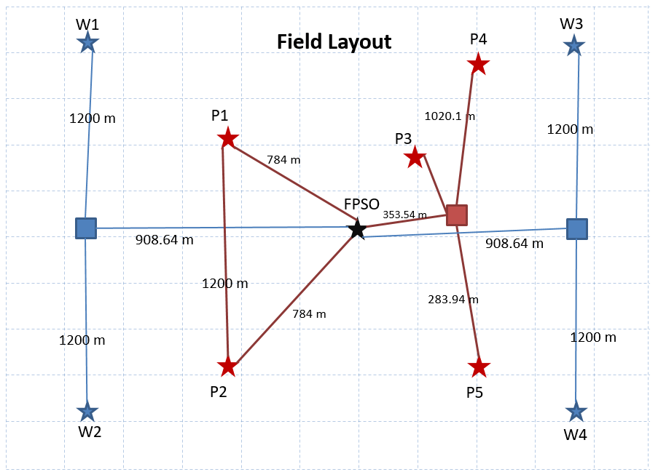
Field Architecture

Slide 5
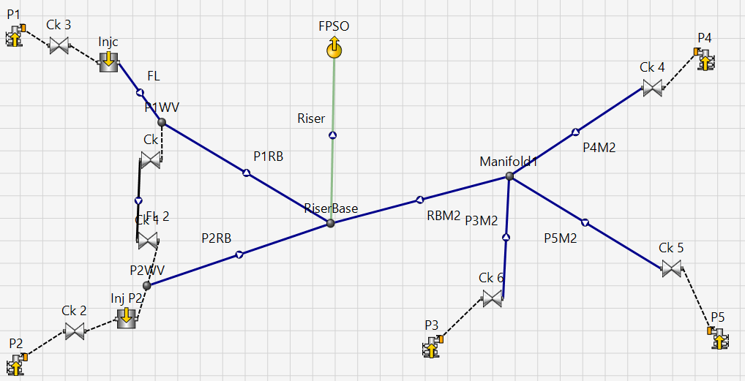
PipeSIM Field Schematic

Slide 6
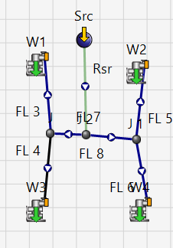
Water Injection

Slide 7
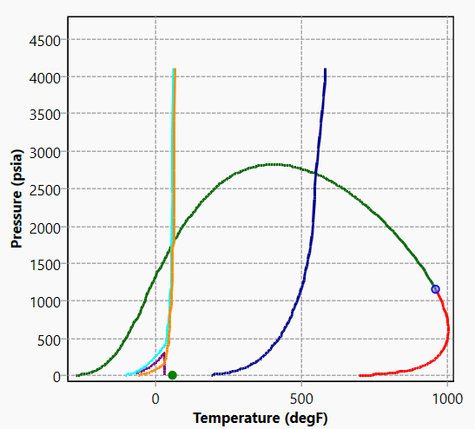
Fluid phase diagram

Slide 8
Modeling and Analysis Approach
Line sizing ( 4 in)
Flowrates as constraints , calculate Reservoir pressure (Mathcad)
Water cut ( composition of fluid model )
Maximum velocity in flowline 12.2 ft/s at P5
Erosional velocity check (fluid density =58.461lb/ft3 API RP 14E 13.8 ft/s)
Insulation
Slugging (slug catcher )
Hydrate formation check (90.2 F at Topside from simulation)

Slide 9
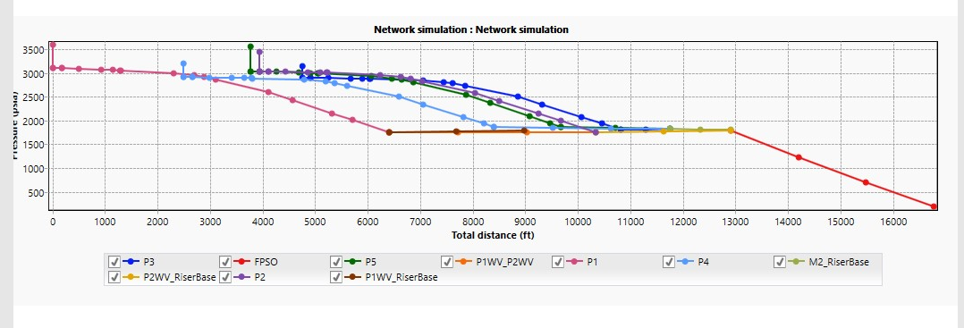
Pressure Profile

Slide 10
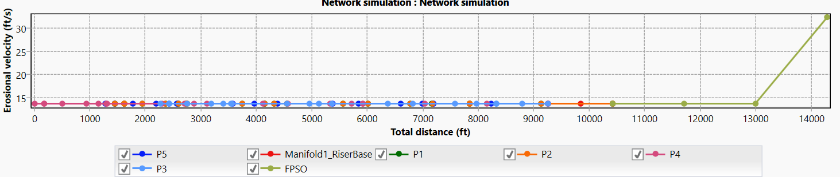
Erosional Velocity Profile
well | pressure
p1 | 4235
p2 | 4199
p3 | 4349
p4 | 4462
p5 | 4510
Pressure at early satge for 4” ID pipeline

Slide 11
Recommendations
Utilize single pipe flowlines with insulation to ensure minimal heat loss throughout field life
Implement Artificial Lift techniques to maintain productivity index in late terms production
Round Trip Pigging capabilities

